Slide 1
National Record Locator
Notes:
Hello and welcome to an introduction to the National Record Locator, a service developed by NHS Digital, provided at no charge to all authorised users, for the benefit of patients and care users throughout the country.

Slide 2
Contents
What does it do?
How does it work?
National Coverage and Growth
IG Overview
What Next?
Prerequisites & Onboarding
Notes:
I’ll be briefly covering what it does, how it works, giving you an idea of where it’s in use, a brief IG overview, where its going next and finally how you can get access to it.

Slide 3
The Vision:
The National Record Locator (NRL) is a national index of pointers to patient records. It enables an authorised clinician, care worker and/or administrator, in any health or care setting, to access a patient’s information to support that patient’s direct care.
The Principles:
The NRL integrates patient record access across the NHS and Social Care without dictating where those records might be stored,
NRL is NOT a central data store for patient records
It is an index that provides the location of records, the technical means to retrieve them, underpinned by an IG framework to safely support sharing on a national scale
Notes:
READ Vision
This opens NRL up to a huge range of potential use cases and care settings.
But it can only be achieved by following simple set of principles.
Crucially, NRL does not store records centrally. The record custodians (or data controllers as they’re known under GDPR) retain the master record and responsibility for its content locally.
NRL only stores an index of those records, showing where they are located nationally, and provides the means to access a read-only copy for the purposes of Direct Care

Slide 4
What does the National Record Locator (NRL) do?
Notes:
So what does the National record locator do

Slide 5


NRL enables cross border record sharing on a national scale – a working example
Lancashire Care
NRL is connecting local and regional sharing initiatives such as LHCRs, Shared Care Records, suppliers, and individual trusts, giving them all a national presence
MENTAL HEALTH CRISIS PLAN
Patient lives in Preston
London Ambulance
Receive 999 call
To scale this up, local data sharing agreements are insufficient so NHS Digital have implemented a National Information Governance model. More on this later….
Retrieve plan from Lancashire Care via the NRL
Patient travels to London
Requires emergency care and calls 999
Notes:
Well the bast way to demonstrate this is via a worked example.
Let’s say we have a mental health patient who lives in Preston
1st click: They are under the care of Lancashire Mental Health Trust, who have created a Mental Health Crisis plan which they share on the NRL.
2nd click: The patient travels down to London on a day trip.
3rd click: For one reason or another, they find themselves in a mental health crisis situation, require emergency care and call 999
4th click: London Ambulance receive the call
5th click: And access the NRL to retrieve the Crisis Plan.
6th click: With this information instantly at their fingertips, they are able to provide better care to the patient at the scene, which may ultimately mean conveying the patient to hospital is unnecessary.
This example only represents the very first use case implemented on the NRL, but hopefully you can see the potential benefit the NRL can provide to many different care settings and document types, some of which are already live or in process of being implemented.
Read Both boxes

Slide 6
Basic Concepts
The NRL is an INDEX of pointers that is used to locate patient records nationally
A Pointer is an entry on the NRL index that points to a single record associated with a patient
A Provider is an organization that makes patient’s records available on the NRL and is responsible for uploading pointers to the NRL (e.g. a care home making End of Life plans available)
A Consumer is an organisation that accesses the NRL to view pointers for a specific patient and retrieve their records for the purposes of Direct Care (e.g. Ambulance Services consuming End of Life plans)
A Consuming Application is used by the consumer to view pointers on the NRL and retrieve records. The consuming application could either be a supplier application integrated to the NRL API or it could be the NHS Digital provided SCRa (Summary Care Record Application). The following slides show examples of the SCRa
Notes:
I’d now like to introduce a few basic concepts before moving on in more detail to explain how the NRL works
READ SLIDES

Slide 7
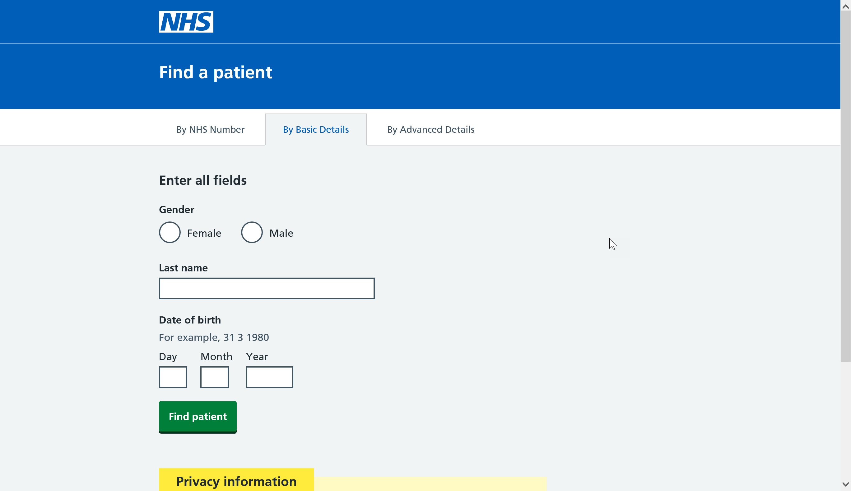
New SCRa – landing page
Notes:
So what does all this look like from a users perspective. Here we have a screenshot of the New SCRa (Summary Care Record Application). Although other alternatives exist, all of our existing consumers have chosen to use the SCRa to access the NRL as it has been developed by NHS Digital and provided to users for free, meaning consuming organisations can be up and running with the SCRa within a very short time period, given there is no development effort required on their behalf.
Once you have logged on to the SCRa via a browser, using your SmartCard, you’ll be able to identify the patient’s NHS number using PDS (Patient Demographic Service).

Slide 8
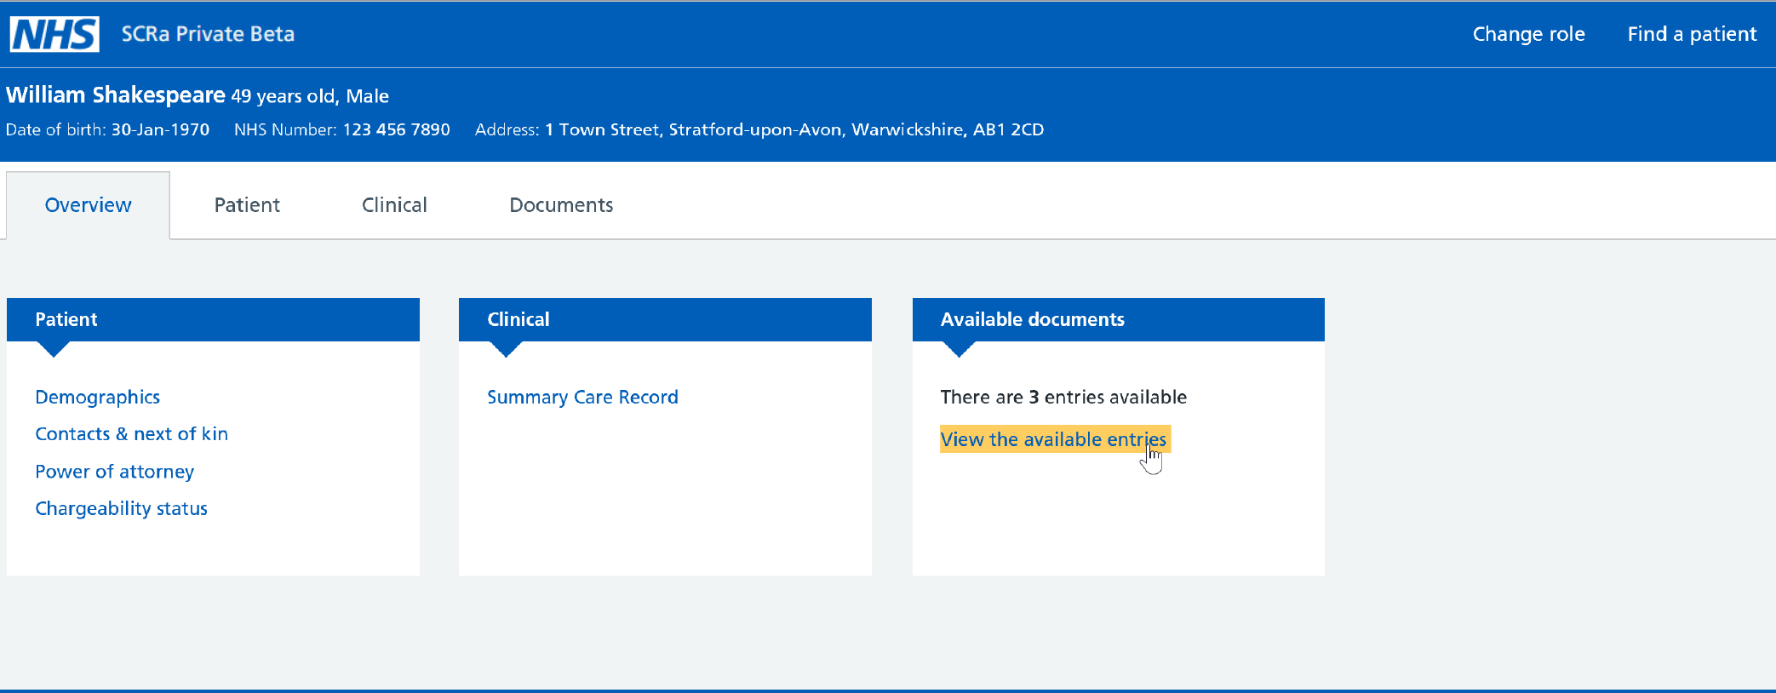
New SCRa – landing page
Notes:
You’ll then be taken to the landing page – the overview. If there are any pointers available for that given patient then this will be indicated in the “available documents” pane.
Clicking on the highlighted link will provide you with a list of all the pointers.

Slide 9
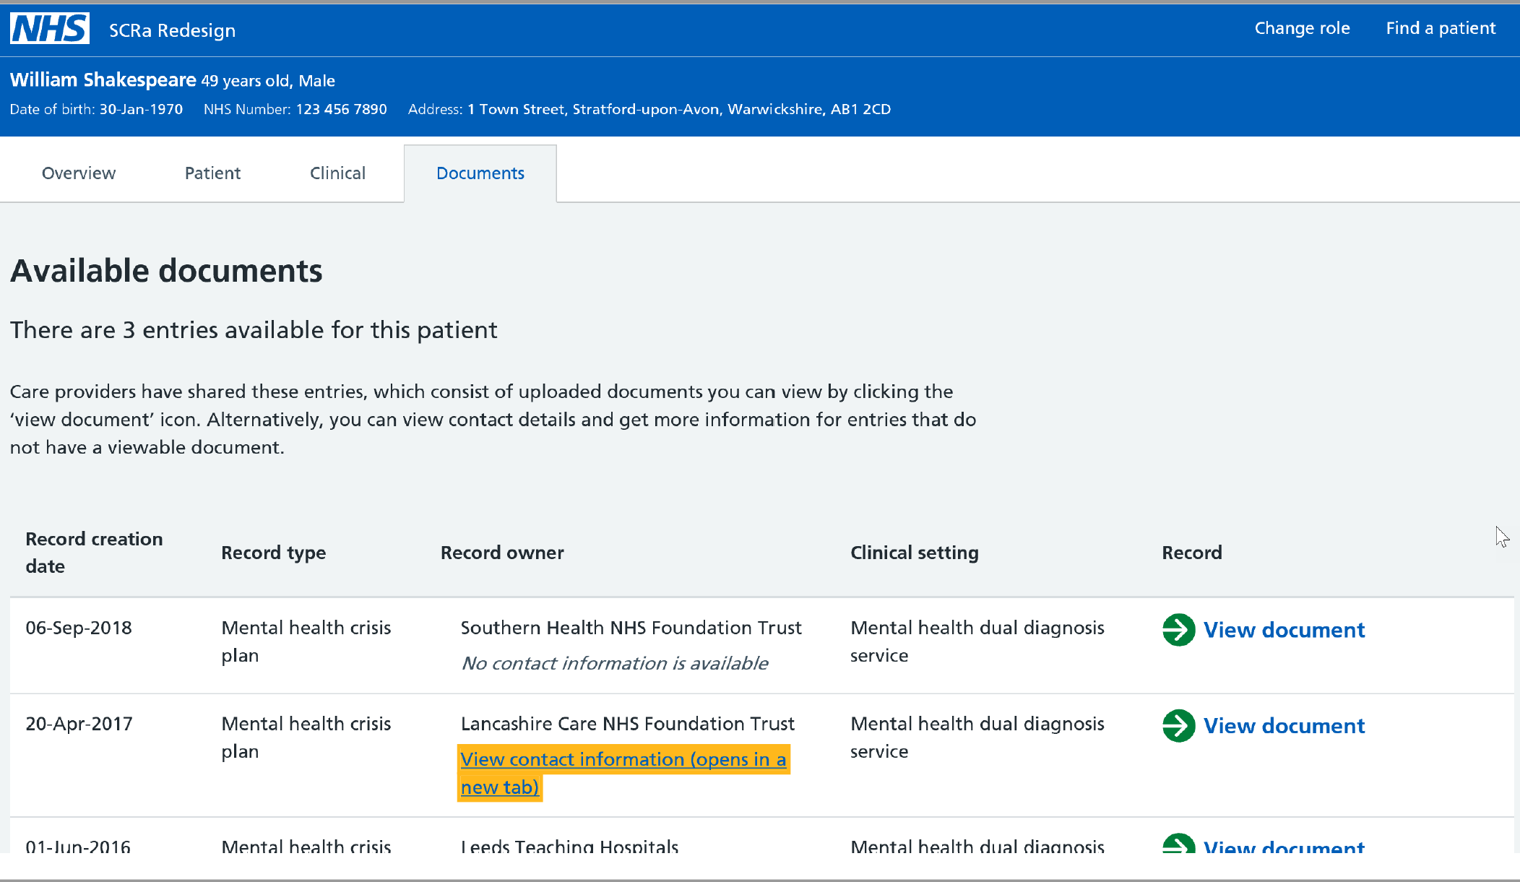
New SCRa - Pointer list view
Notes:
In this example, we can see that one of the providers, Lancashire Care Foundation Trust, have chosen to make contact information available to the consumer. This is particularly useful in situations where either a document is not available for retrieval or the consumer would like to call the team responsible for providing care to the patient.

Slide 10
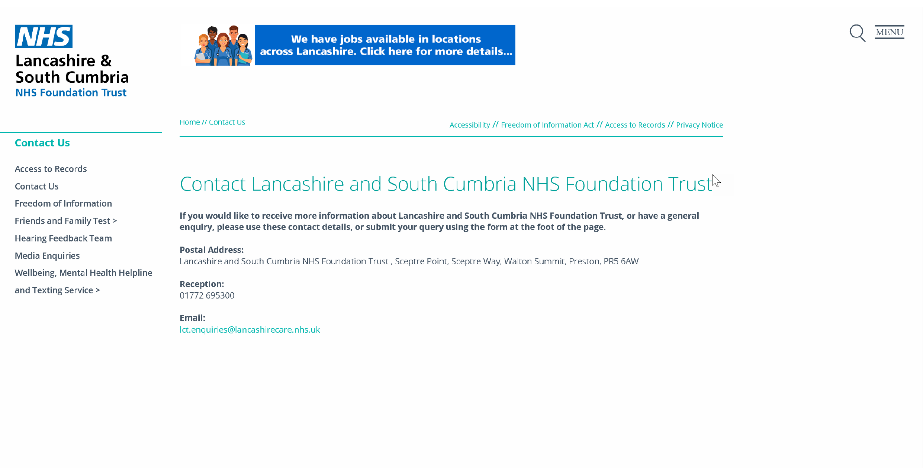
Optional - Provider Contact Details (available on the WWW)
Notes:
By clicking on the contact information, we are taken to a publicly available web page hosted by the providing organisation. Returning to our original example, this could be the specific crisis team within Lancashire Care that is responsible for providing care to that patient.

Slide 11
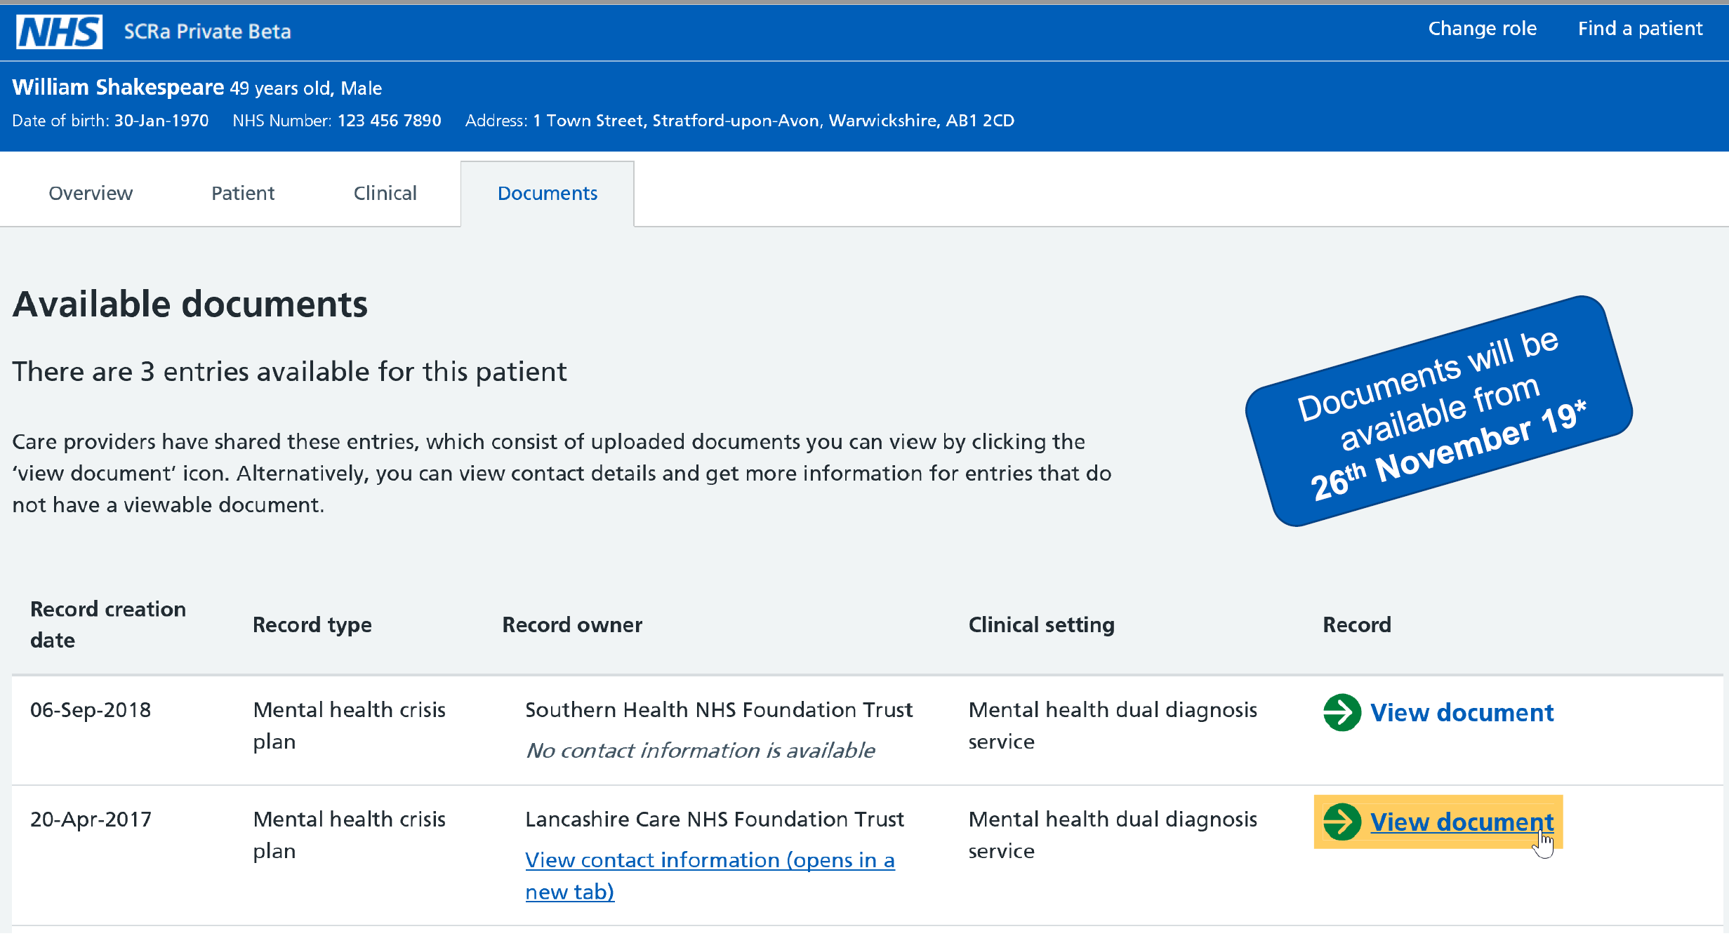
New SCRa - View document link
Record Retrieval LIVE December 2019
Notes:
The other link available on the pointer is to initiate record retrieval. By clicking on “view document” we are able to retrieve a read-only snapshot of the crisis plan held at the Trust.

Slide 12
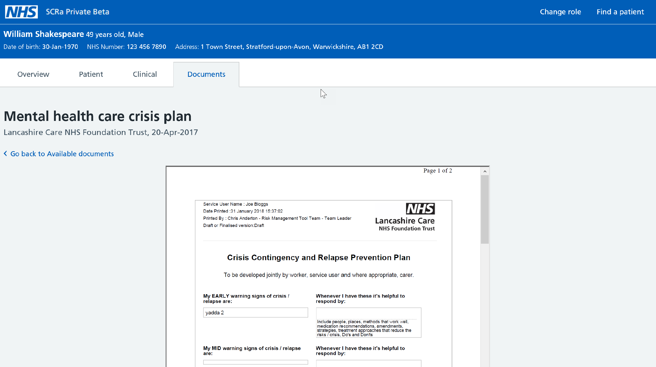
New SCRa - Record Retrieval
Notes:
And here we have the crisis plan itself.
So picture this, you’re a paramedic, in an ambulance on the way to treat a patient who has reported to be in crisis. Not only has NRL identified that the patient is a mental health patient but it has provided you with the means to best treat that patient before you’ve even arrived at the scene. Now apply that same logic to all of the different record types and use cases you can think of and you’ll start to get an idea about the full potential that the NRL has to offer.
I referred to it as a snapshot because I wanted to emphasise that NRL is not about transferring documents between one organisation and another. The provider retains responsibility for maintaining the document. So if a consumer retrieves a document on the NRL on a Monday and finds they need to access the same document a week later they must access the NRL again – this way they can ensure that they pick up any updates made by the provider in the interim period.

Slide 13
How does NRL work?
Notes:
So how do we make this happen?

Slide 14





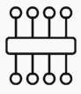

NRL Overview
Patient record
Search NRL and
view pointers
NRL
Create
Pointer
2
Retrieved record can be viewed by:
Desktop SCRa
Mobile SCRa
Directly integrated consumer application.
1
NRL PROVIDER
NRL CONSUMER
Request record
Request record
SPINE
SECURE
PROXY
4
5
Return record
Retrieve and view record
3
View contact details using browser
WWW
14
Notes:
1st Click: The provider creates the pointer which is uploaded to the NRL.
2nd Click: The consumer searches for pointers on the NRL
3rd Click: If a link to publicly available contact details has been provided for the individual or teams caring for the patient, then these can be accessed over the internet.
4th Click: The consumer retrieves the record from the provider.
5th Click: All of these interactions are channelled centrally via the NRL and the Spine Secure Proxy ( the SSP) which handle all authentication and authorisation centrally. This gives us the means to scale up record sharing nationally as organisations no longer need to perform multiple, separate point-to-point integrations – only a single integration with the NRL is required.
6th Click: Retrieved records can be viewed either on the Desktop version of the new SCRa that we saw earlier using Smartcards, or on a mobile version of the SCRa accessible from I-Pads integrated with the NHS Identity Service, making use of biometric authentication such as fingerprints instead of smartcards. Alternatively, a consumer can integrate directly with NRL’s API to provide access from within their native application.

Slide 15
National Coverage and Growth
Notes:
So where is the NRL in use and who are we working with

Slide 16
NRL Coverage and Growth
Already Live in 5 regions covered by ambulance services, with the remaining 5 actively engaged to complete full national coverage
Existing Use Cases:
Mental Health Crisis Plans
E-RedBag
End of Life
About Me
Emergency Health Care Plan
More on the way!
Integrated across multiple Trusts, Care Homes and Shared Care Records with many more, (including LHCRs) in the pipeline.
Bringing together the sharing power of multiple suppliers on a single, national platform
Since initial go-live in 2018:
Over 85,000 pointers uploaded
Over 20,000 searches on SCRa with over 250 records retrieved
Notes:
1st Click: READ
2nd Click: READ then:
3rd Click: This is particularly important. We’re not here to compete with suppliers or regional sharing initiatives. We’re here to stitch them together and offer them a truly national platform to share the information they hold. So, in fact, we need them to grow and prosper so that the information they share via the NRL becomes richer and more widely available.
4th Click: READ
5th Click: READ

Slide 17
IG Overview
Notes:
As the health industry has learnt from previous engagements it’s no good having a working technical model unless it is underpinned by a robust Information Governance model that complies with the latest GDPR legislation.
NRL has gone through a comprehensive consultation to develop its IG model that has been approved by IG and Legal experts, The Data Protection Office, and Caldicott Guardian.

Slide 18
IG Principles and Legal Basis for Sharing
Direct care
Information: To Share Or Not To Share? The Information Governance Review
Lawful basis
Typically this will be 6(1)(e) ‘…necessary for the performance of a task carried out in the public interest or in the exercise of official authority…’
Legitimate relationship must exist
Consumers to manage locally. Must be able to prove.
Must have IG roles in place to support NRL
Caldicott Guardian, Data Protection Officer, Privacy Officer
Article 6(1)(e) ‘…necessary for the performance of a task carried out in the public interest or in the exercise of official authority…’
Article 9(2)(h) ‘…medical diagnosis, the provision of health or social care or treatment or the management of health or social care systems…’
All participants of the NRL service must sign up to the NRL DSA (Data Sharing Arrangement). This removes the need for point-to-point sharing agreements and ensures that all participants are operating to the same, consistent, known set of principles and responsibilities.
Notes:
Our IG Principles are based upon the service being used for Direct Care, where there is a lawful basis and only by those who have a legitimate relationship with the patient. All participating organisatioons must have appropriate IG roles in place to undertake their own assessment and to ensure they fulfil their own responsibilities under GDPR.
Our IG Model has been developed to operate at a national scale, meaning all participants only need to sign a single Data Sharing Arrangement once. This removes the need for multiple point-to-point sharing agreements and ensures that all participants are operating to the same, consistent, known set of principles and responsibilities.

Slide 19
Access Control Model
NRL Consumer A
NRL
NRL Providers
Organisational
Restriction
NRL Consumer B
NRL Provider makes record available on NRL
Records available to NRL Consumers based on their organisation type
Notes:
Our access control model includes an organisational filter. This helps us to minimise the risk of organisations receiving pointers to record types which they have no legitimate reason to be viewing. Of course this doesn’t remove the need to exercise the usual methods of professional responsibility, audit and disciplinary measures that organisations already apply at a local level.

Slide 20



Authentication & Role Based Access Control
Smartcard / NHS Identity + RBAC
System auth.
NRL
Consumer
Pointer
NRL / SSP
Pointer
NRL
Provider
Record
Smartcard / NHS Identity + RBAC
Nationally defined RBAC model controls access to the NRL for consumers using the SCRa and provides two tiers:
1. Full access to pointers, contact information and document retrieval.
2. Restricted access to pointers and contact information only.
Locally defined RBAC for API integrated solutions
Additional control possible for sensitive document types
Notes:
We have a nationally defined Role Based Access Control model that is applied to consumers accessing the NRL via the SCRa. This allows organisations to implement two tiers of access if they wish to:
1. Full access to pointers, contact information and document retrieval.
2. Restricted access to pointers and contact information only.
Organisations that integrate directly into their own software solution have full flexibility to define their RBAC in line with their own local policies.
We have future proofed the solution by providing an additional category for sensitive document types. These are only expected to be used in extreme circumstances for record types such as FGM or adoption; our current set of approved record types all sit within the general use category.

Slide 21
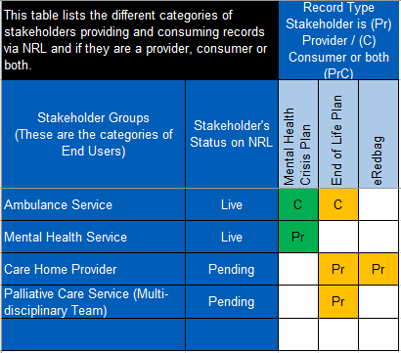
IWG and the Controller Catalogue
The IWG (Integrated Working Group) consists of SMEs (Clinical, IG, Tech Arch, Terminology, Live Services etc) that assess applications to:
Become a provider.
Become a consumer.
Introduce a new record type.
All Providers, Consumers and Record Types are recorded on the Controller Catalogue for full transparency and to ensure providers have access to the information to fulfil their responsibilities as a data controller.
Notes:
If you’d like to join the NRL as a new provider or a new consumer, or even introduce a new record type then shortly after getting in touch with us we’ll likely send you an application form for you to complete to submit your request to the Integrated Working Group.
The IWG is an NHS Digital group of SMEs from a range of disciplines including clinical, IG and technical amongst others that act as a gateway to the sharing club. They’ll assess your application and ensure that NRL is the right tool to meet your business need.
Once approved, we add all new providers, consumers and record types to the Controller Catalogue. This is available to all participants and but is particularly useful for providers to ensure they can meet their GDPR obligations by understanding exactly who their patient records are being shared with at any given time.

Slide 22
What Next?
Notes:
So what next for NRL

Slide 23
Upcoming Service Enhancements
Integration with LHCRs (Local Health Care Records)
Availability of mobile SCRa on other mobile device types in addition to I-pads (e.g. Windows, Android)
New Use Cases and Record Types
Retrieval of Structured Records (currently limited to PDF)
Notes:
Now that the solution has proven its benefit in live service our main focus is expansion.
1. So, as I mentioned before we’re on the lookout for new use cases and record types – so if you think you might have one, we’re keen to hear from you!
2. We’re currently limited to sharing via PDFs in recognition that some of the record types do not have confirmed PRSB standards in place and therefore may vary in exact content from provider to provider. That said, the NRL already supports structured record retrieval and it’s only a matter of time before a use case that requires it comes along.
3. The mobile version of the SCRa is currently only available on i-pads but the NHS Identity Team are looking at ways to make it available on other devices such (windows and android being top of the queue)
4. Finally, the NRL is engaged with LHCR community (Local Health Care Records) to develop a model whereby they are able to share amongst each other and beyond, again using the NRL as a central hub.

Slide 24
Pre-requisites & Onboarding
Notes:
So how do you get access to the NRL?

Slide 25
Provider/Consumer API Integration - Prerequisites
A valid ODS code
NHS number verification method via any of the following mechanisms:
Full PDS Spine compliant system
Spine Mini Service PDS (SMSP)
Demographics Batch Service (DBS)
Approved authentication method required only if consuming from NRL (currently, Smartcard or NHS Identity integrated solution (https://digital.nhs.uk/services/nhs-identity)
Completion of DSPT (Data Security Protection Toolkit) within the last 12 months
Annual Security Testing (to CHECK standards)
Clinical Safety Officer to undertake a Clinical Safety Assessment
Notes:
Lets start with the provider and consumer pre-requisites if you are looking to integrate with the NRL API to share information.
1. READ
2. READ As part of it’s internet first initiative, NHS Digital are looking to move as many of its services onto the internet as possible. Depending on which verification service you use, you may require an N3 or HSCN connection to access it.
3. You’ll need an approved authentication method only if consuming from the NRL. This can either be using a smartcard or an NHS Identity Integrated solution such as the i-pads that London Ambulance Service are currently using to access the NRL on the road using biometrics.
4. READ
5. READ
6. READ

Slide 26
Provider/Consumer API Integration - Onboarding Process
Commence any applicable local clinical safety / IG assessments
Review onboarding documentation
Development against online reference implementation
Local testing using TKW
Integration Testing in the NHS Digital path-to-live environments
Complete the Supplier Conformance Assessment List (SCAL)
Sign DSA (Data Sharing Arrangement) and Connection Agreement
Obtain all necessary local approvals for go-live (e.g. clinical safety, IG, board approvals)
LIVE pipe-cleaning
Further detail is included in the NRL Onboarding Guide (for Direct API Integration).
(https://github.com/nhsconnect/FHIR-NRLS-API/tree/develop/content/uploads/onboarding)
Technical Specification available here: https://developer.nhs.uk/apis/nrl/
Notes:
Assuming you can meet these pre-reqs, then the onboarding process is relatively straightforward.

Slide 27
Consumer (SCRa) - Onboarding Process
Commence any applicable local clinical safety / IG assessments
Update local Business Processes and Train Users (guides are available)
Obtain all necessary local approvals for go-live (e.g. clinical safety, IG, board approvals)
Deploy latest NHS Identity Agent to all users (where not already in place)
Deploy National Identity Hub to all users
Add RBAC codes for each user
Sign NHS Digital DSA (Data Sharing Arrangement) for NRL
Perform Live Validation with a test pointer and record
NHS Digital can guide you throughout the whole process ☺
Further detail is included in the NRL onboarding guide (for Consumers using SCRa only).
Notes:
If you’re looking to consume from the NRL using the SCRa the onboarding process is even simpler and can often be achieved within just a few weeks.

Slide 28
Resources
Service overview https://digital.nhs.uk/services/national-record-locator/
Technical specification https://developer.nhs.uk/apis/nrl/
Demonstrator https://nrls.digital.nhs.uk/system-demo/5cac75015de844a79d3d63b8/SCRa
Reference implementation https://data.developer.nhs.uk/nrls-ri/index.html
Onboarding guide and resources https://github.com/nhsconnect/FHIR-NRLS-API/tree/develop/content/uploads/onboarding
If you have any questions, please contact the team via nrlnems.ls@nhs.net
Notes:
I hope you’ve enjoyed the presentation today. Listed on the screen are links to a number of resource where you can find further detail:
A service overview can be found on the NHS Digital website, which gives an introduction to the NRL, covering the use cases and benefits.
The technical specification is a one stop shop for all technical personnel looking to integrate with the NRL using the NRL FHIR API. It provides detail on all API interactions and technical requirements.
A demonstrator is available online which shows how NRL can be used in a Consumer system.
There is an online reference implementation, which can be used to explore the API and test out the various functions available.
Finally, the onboarding guide is available on github and provides all the information required to integrate the NRL service from initial engagement to going live, with step by step guidance and directions to supporting resources.
This slide deck is available online where you can access the links to the resources. If you have any questions or would like to start the onboarding process, please contact the team using the email address shown.

Slide 29
Contact us:
nrlnems.ls@nhs.net
Notes:
Many Thanks for listening. We look forward to hearing from you soon.

